Slide 1



ARCHITECTURE OF ELECTRONIC COMPUTING MACHINE & COMPUTING SYSTEMS
Prepared & Presented by: Mirlan Nurbekov, Lecturer
Office hours: Friday 9:00–17:00
AlaToo IT & Business College
Fall 2025

Slide 2
Basic circuit constructions
Build a basic circuit on a breadboard to control an LED using a 4-pin switch.
- 1 - LED
- 1 - Resistor (220Ω – 330Ω)
- 1 - 4-pin push button switch
- 1 - Battery (or 5V power supply)
- 1 - Breadboard
- 4 - jumper wires

Slide 3
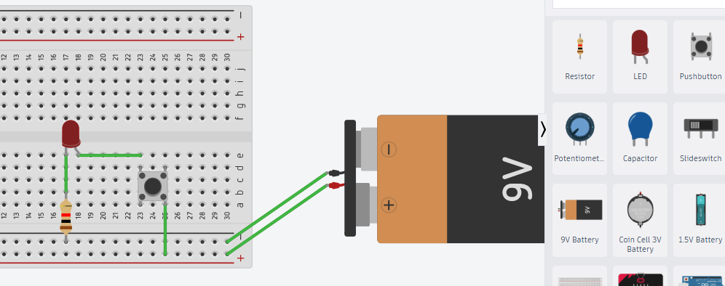
Basic circuit constructions

Slide 4
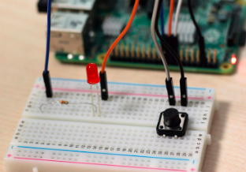

Slide 5

Purpose
Code gives purpose to a simple circuit, allowing it to act automatically instead of relying on manual input.

Slide 6
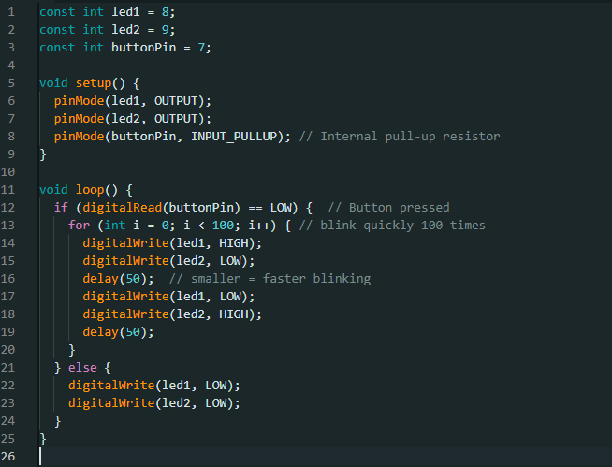

Slide 7

Enhancing functionality with code

Slide 8
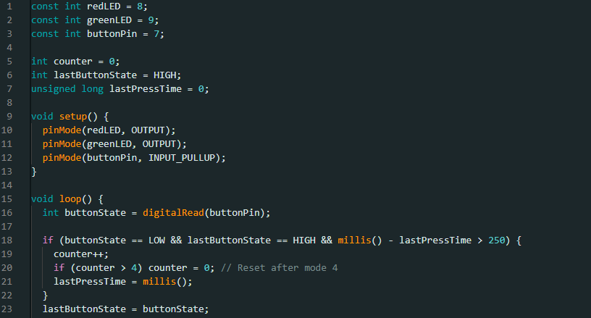

Slide 9
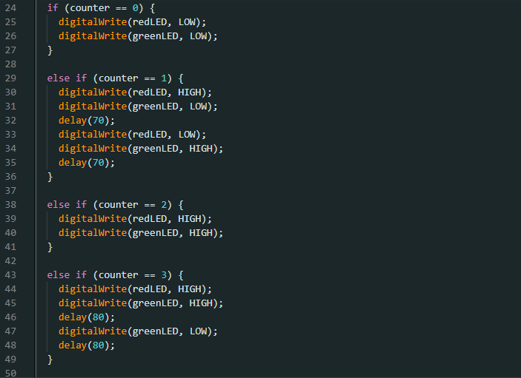

Slide 10
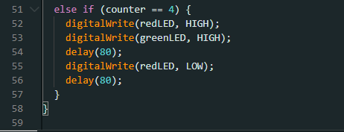

Slide 11
Design a circuit where an LED smoothly fades in and out like a “breathing” effect. The brightness should gradually increase and decrease over a 4-second cycle, then repeat continuously.
Add a button that acts as a power switch for the circuit:
When the button is pressed once, the LED starts the breathing effect.
When the button is pressed again, the LED turns off and stops fading.
The button must toggle between ON and OFF states properly (no bouncing).
Task 0000

Slide 12
Components required:
1 × Arduino Uno (or similar)
1 × LED
1 × 220 Ω resistor
1 × Push button
Jumper wires and breadboard

Slide 13
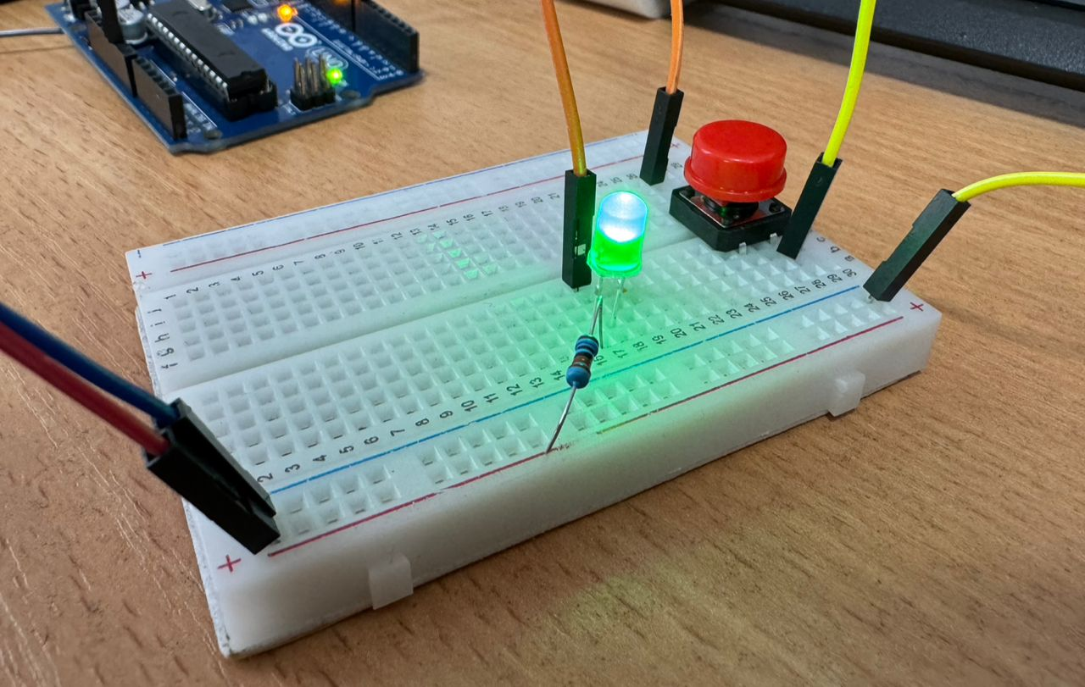

Slide 14
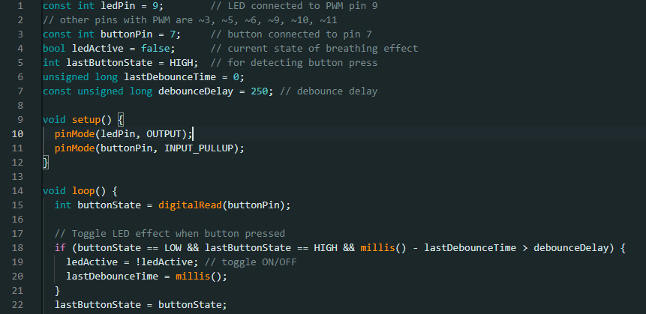

Slide 15
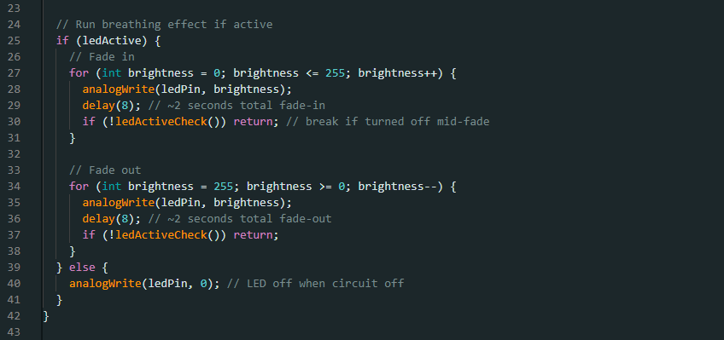

Slide 16
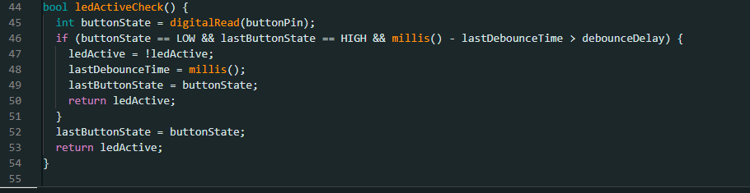

Slide 17
Design a temperature monitoring system using the LM35 temperature sensor, two LEDs, and one button. The system should stay inactive until the button is pressed, after which it continuously monitors the temperature and reacts accordingly. When the circuit starts, everything should be off (LED1 and LED2 are off). When the button is pressed, the circuit becomes active: LED1 turns on to show the system is running. The microcontroller continuously reads the LM35 sensor value. If the temperature rises above 30°C, turn LED2 ON. When the temperature falls below or equal to 30°C, turn LED2 OFF again. The circuit should stay active (monitoring temperature) until the microcontroller is reset.
Task 0001

Slide 18
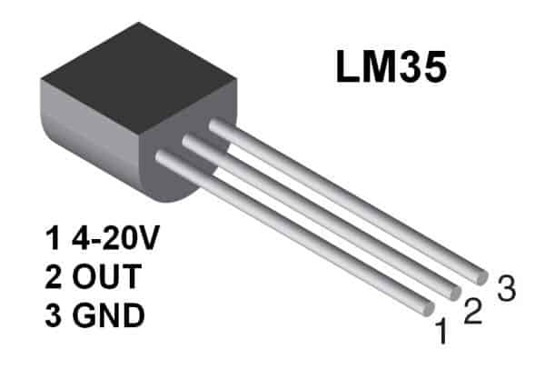

Slide 19


Slide 20
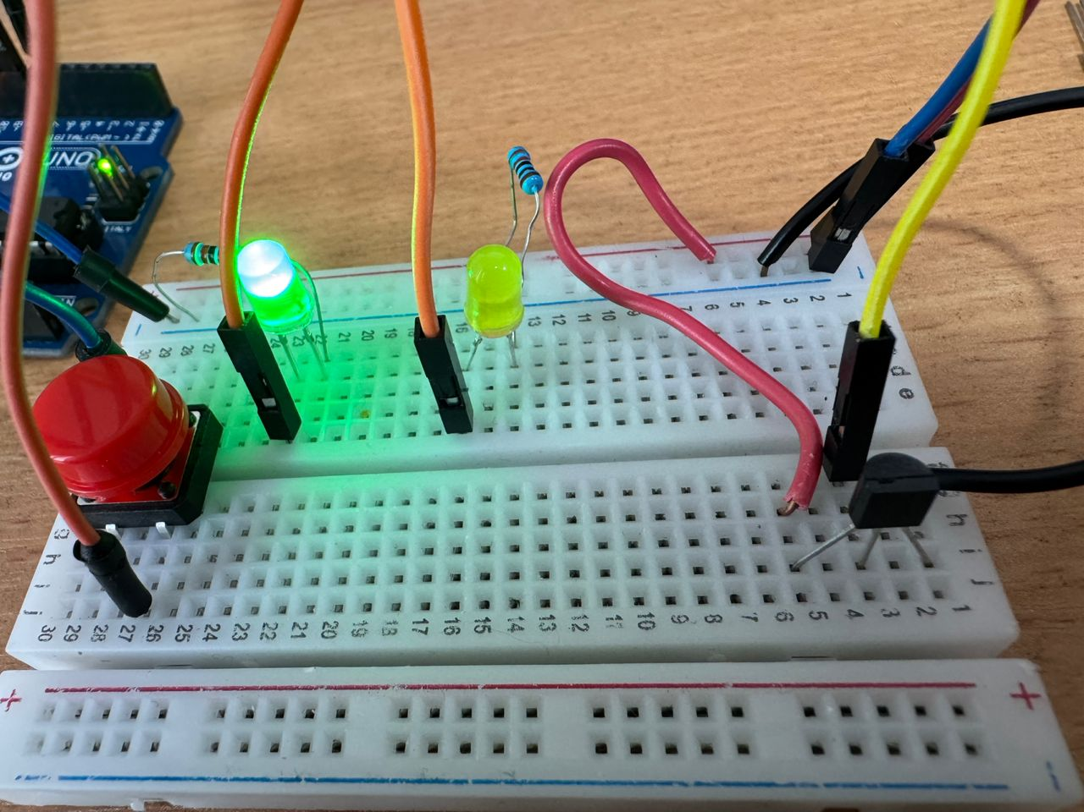

Slide 21
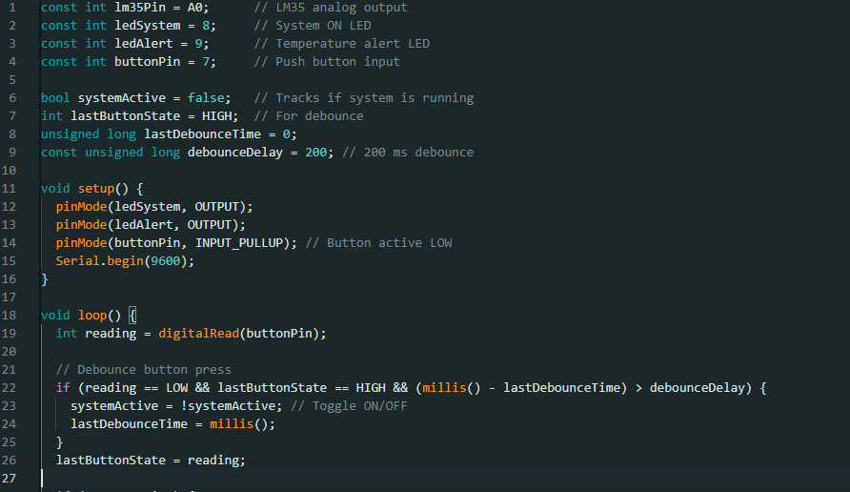

Slide 22
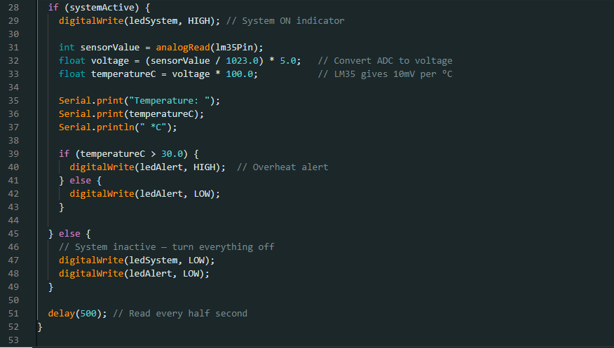

Slide 23
Design and program a circuit using a joystick and two 9g servo motors — Servo1 and Servo2. When the system is inactive, both servos should stay at 90°. Pressing and moving the joystick should control the servos in real time as follows:
X-axis movement:
Joystick moved fully left → Servo1 rotates to 0°
Joystick moved fully right → Servo1 rotates to 180°
Y-axis movement:
Joystick moved fully up → Servo2 rotates to 120°
Joystick moved fully down → Servo2 rotates to 0°
When the joystick is in neutral position (idle), both servos return to 90°.
Task 0003

Slide 24
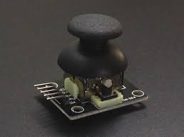

Slide 25
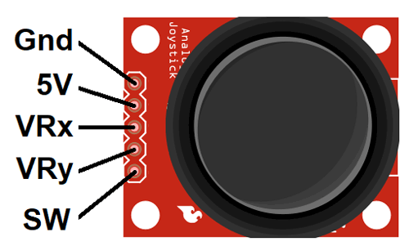

Slide 26
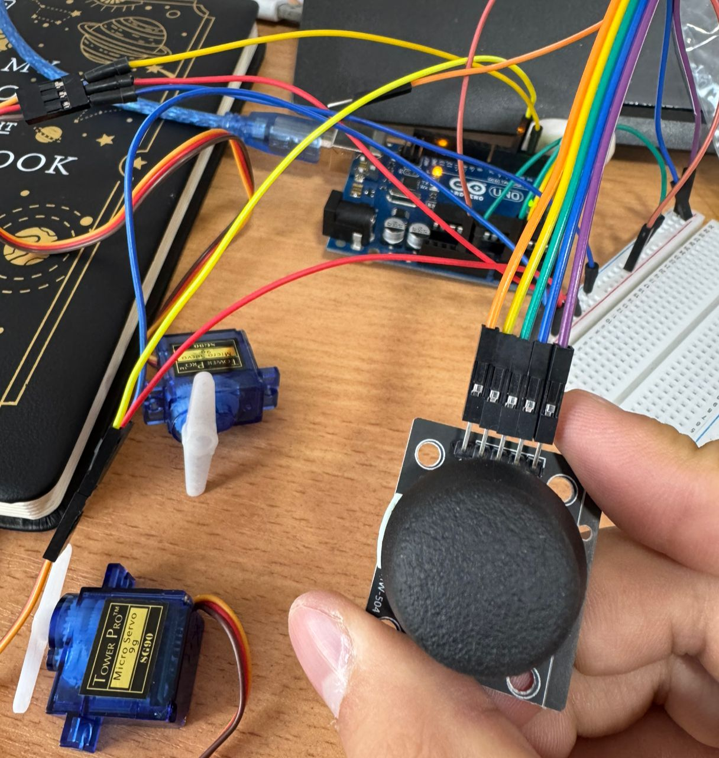

Slide 27
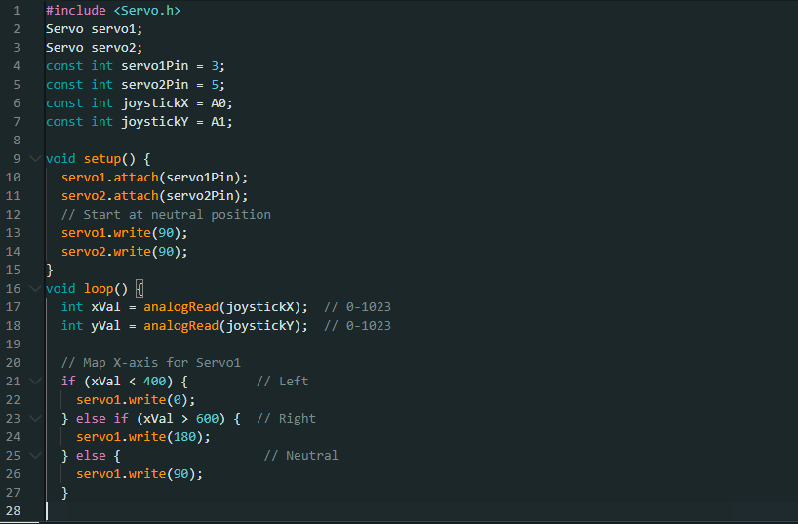

Slide 28
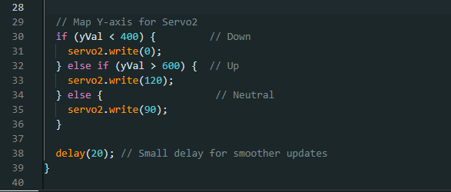

Slide 29
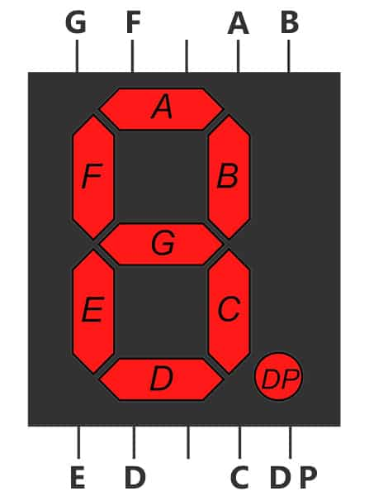
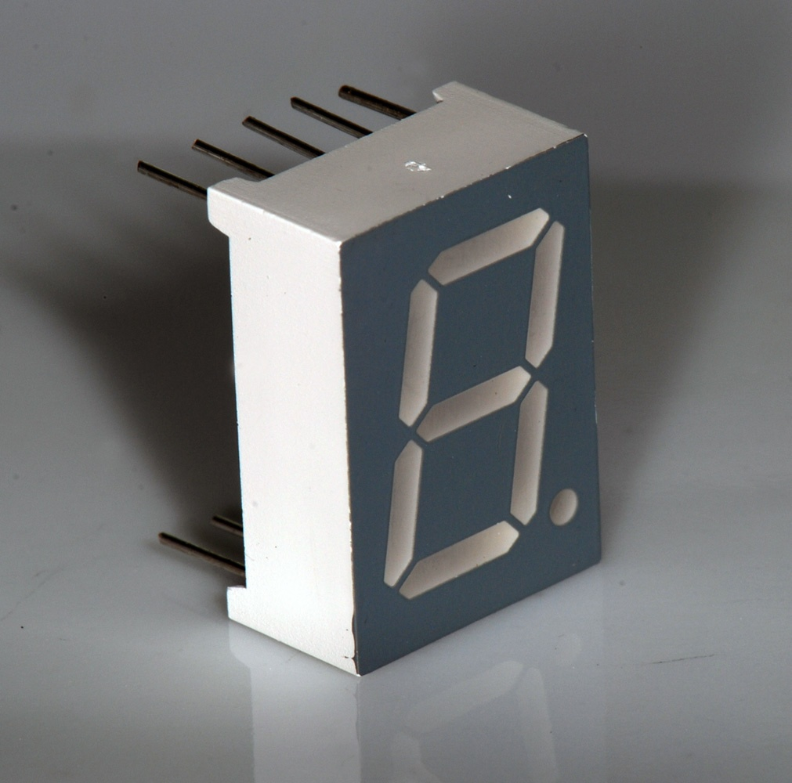
7 segment display

Slide 30
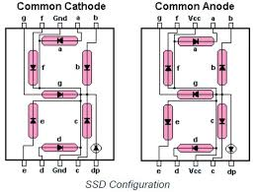
7 segment display

Slide 31
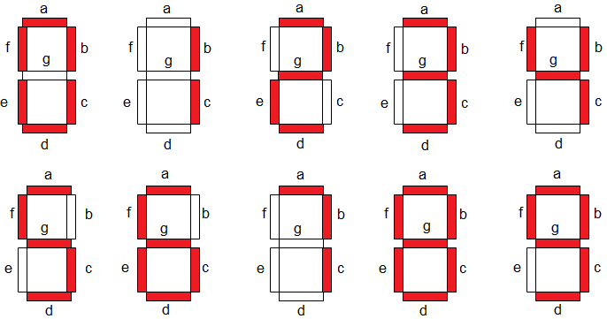
7 segment display

Slide 32
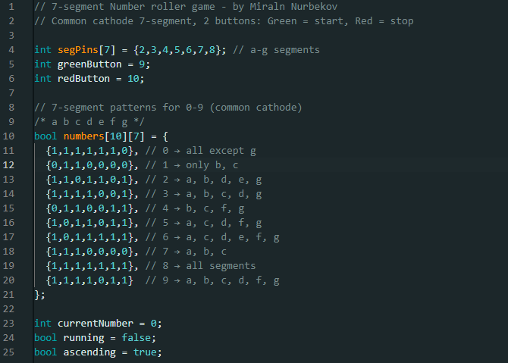

Slide 33
Segment | Arduino Pin
a | 2
b | 3
c | 4
d | 5
e | 6
f | 7
g | 8

Slide 34
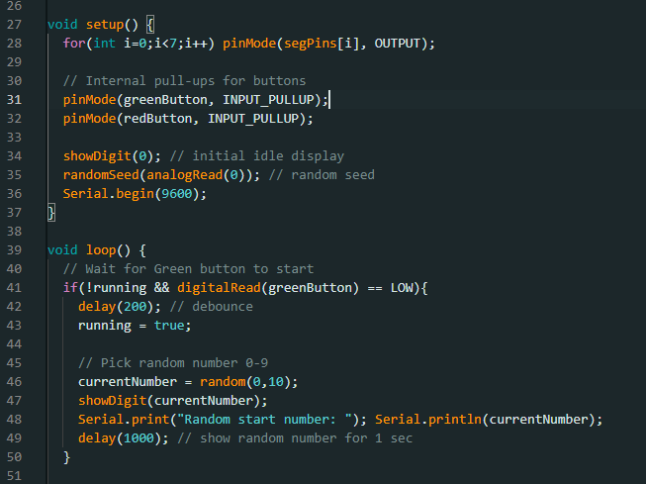

Slide 35
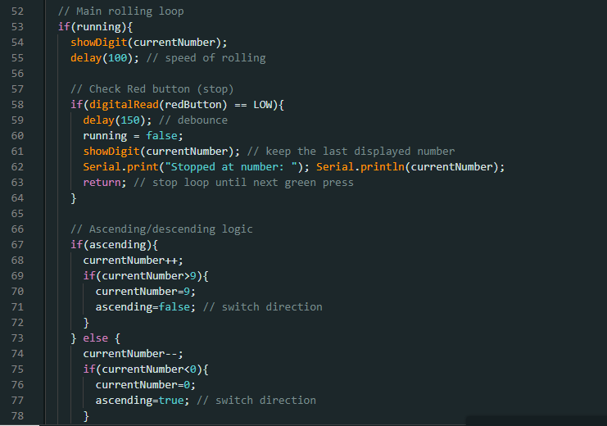

Slide 36
